Slide 1
게임엔진2 제9주
Pole and Direct Interactor
드론IoT시뮬레이션학부
담당교수 : 이형원
E304호, hwlee@inje.ac.kr

Slide 2
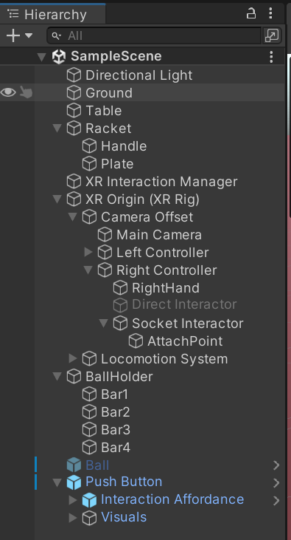
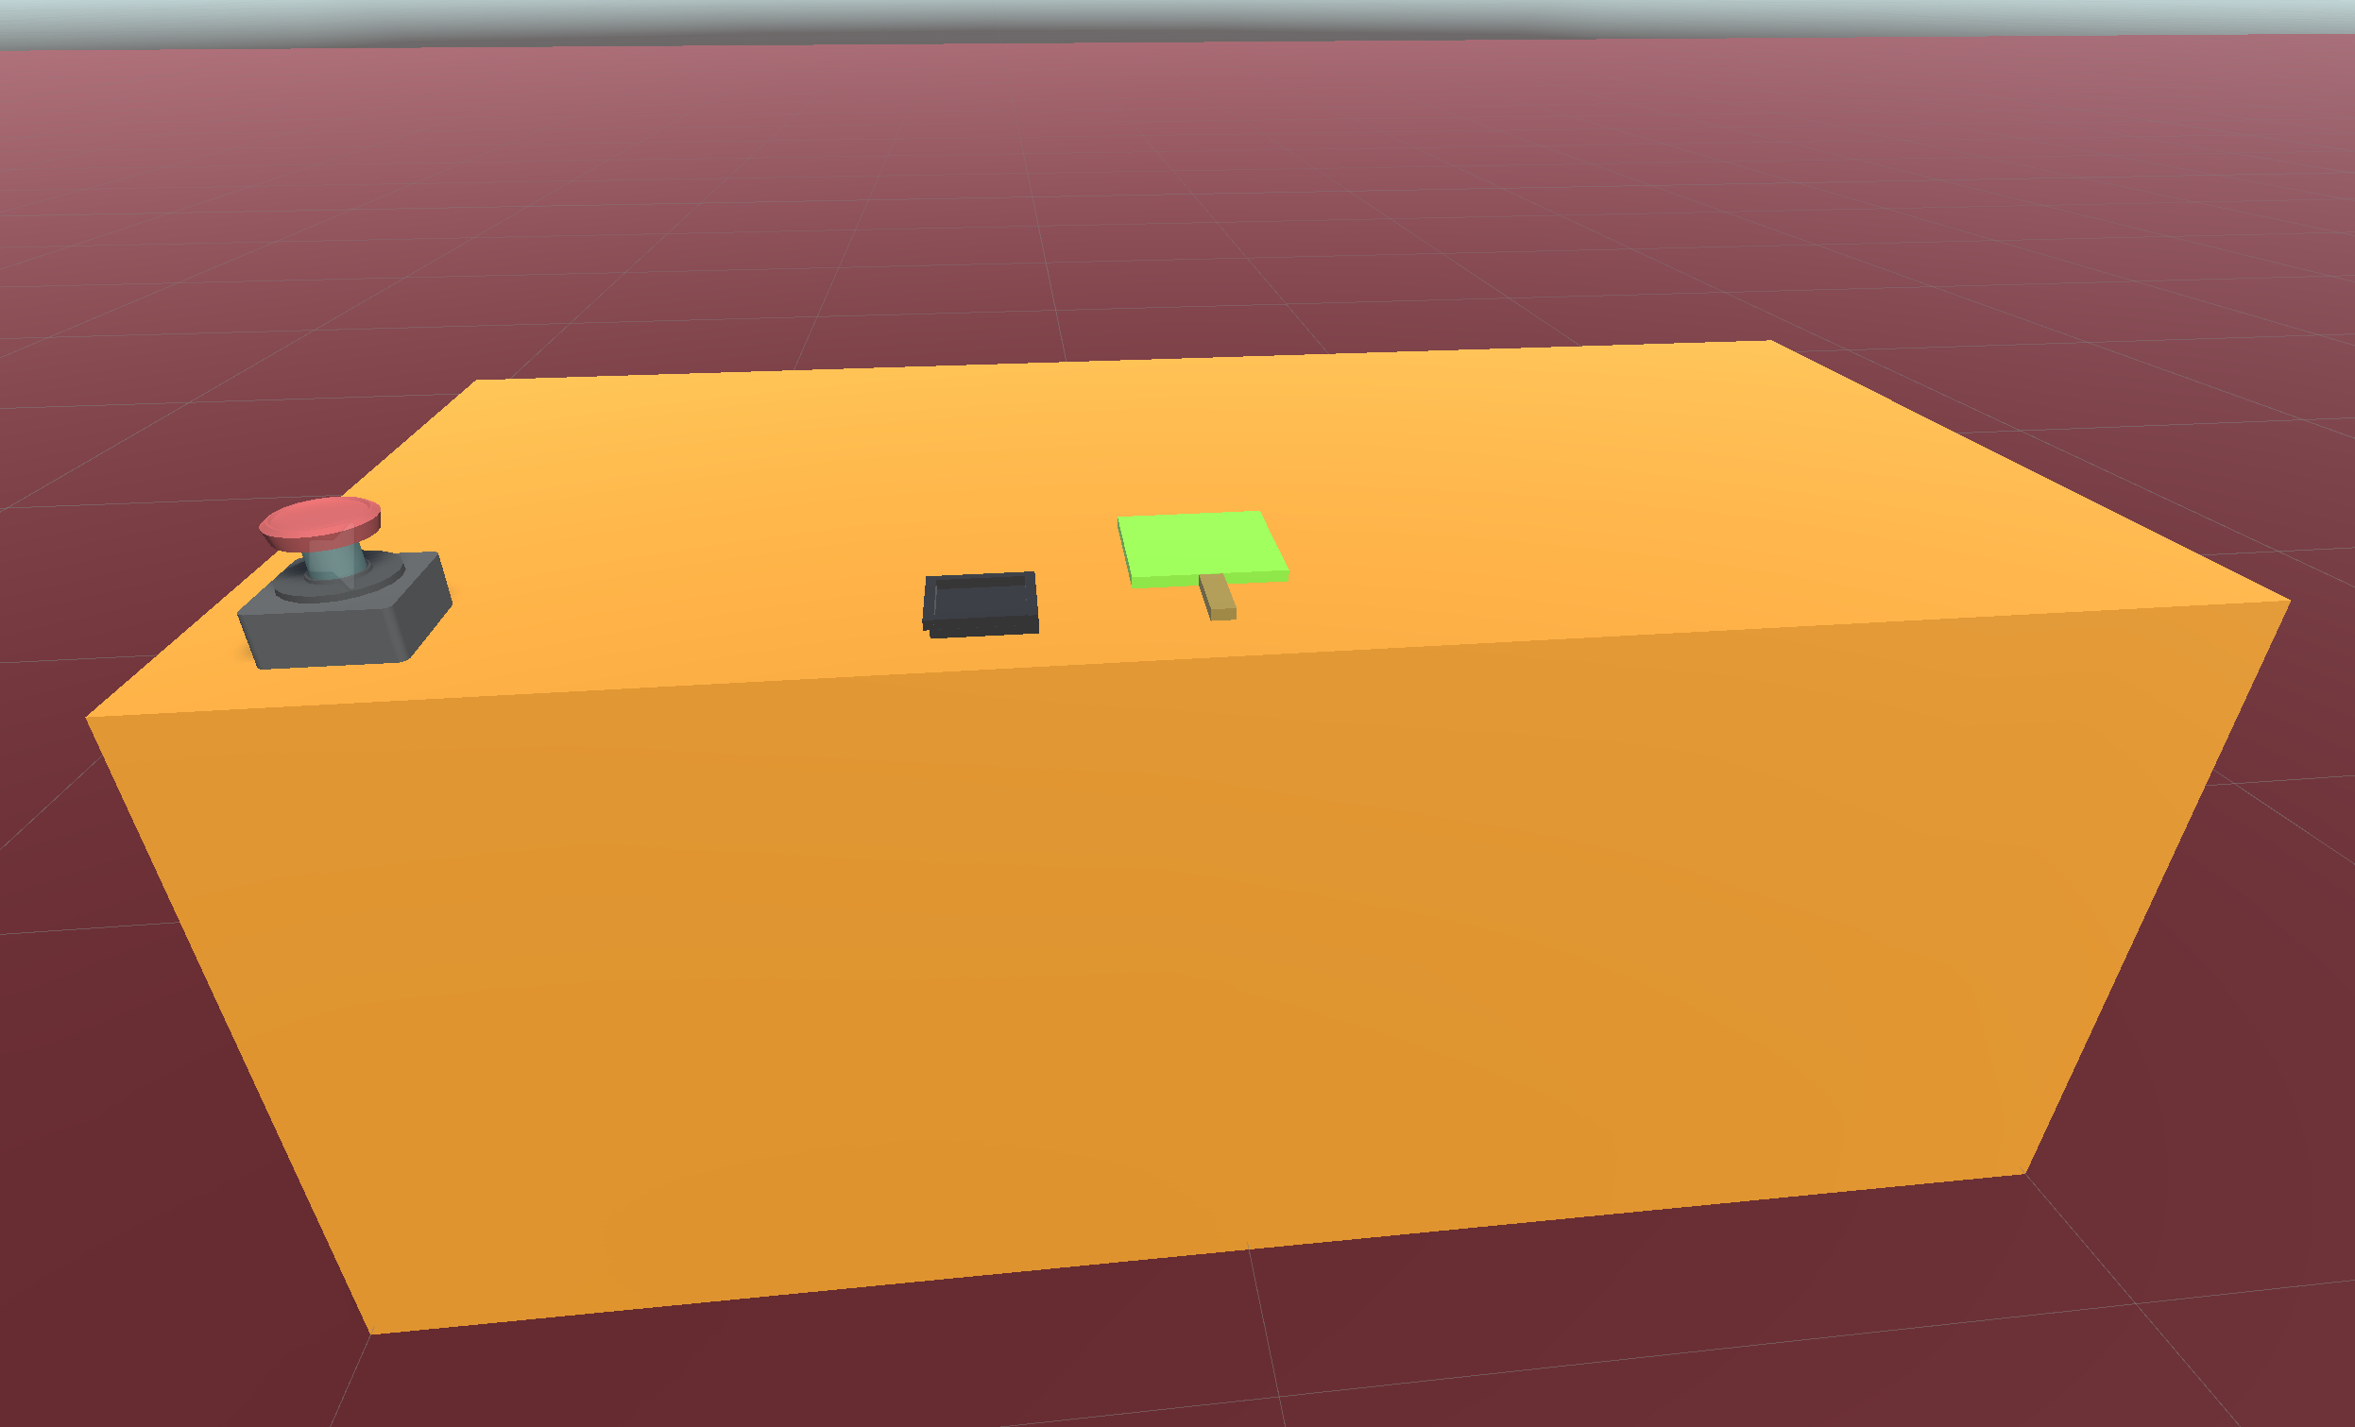
만들어 볼 게임
BallTouch.mp4
Poke Interactor Button

Slide 3
제작 순서
프로젝트 생성
XR Plug-in Management 설치
XR Interaction Toolkit (2.5.2) 설치
Plane등 환경 객체 추가
XR Origin (VR) 추가
각종 Interactor, Interactable 추가

Slide 4
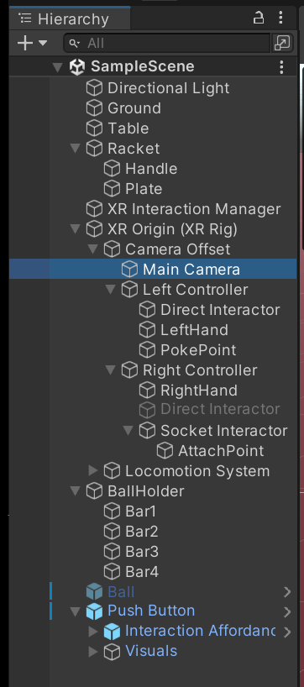
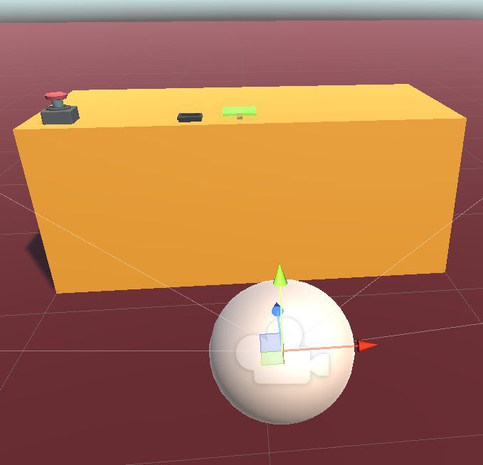
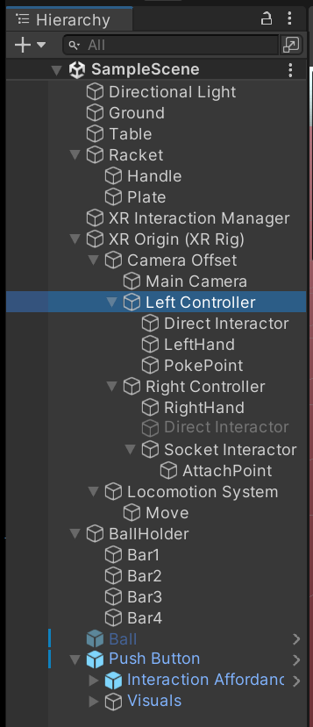
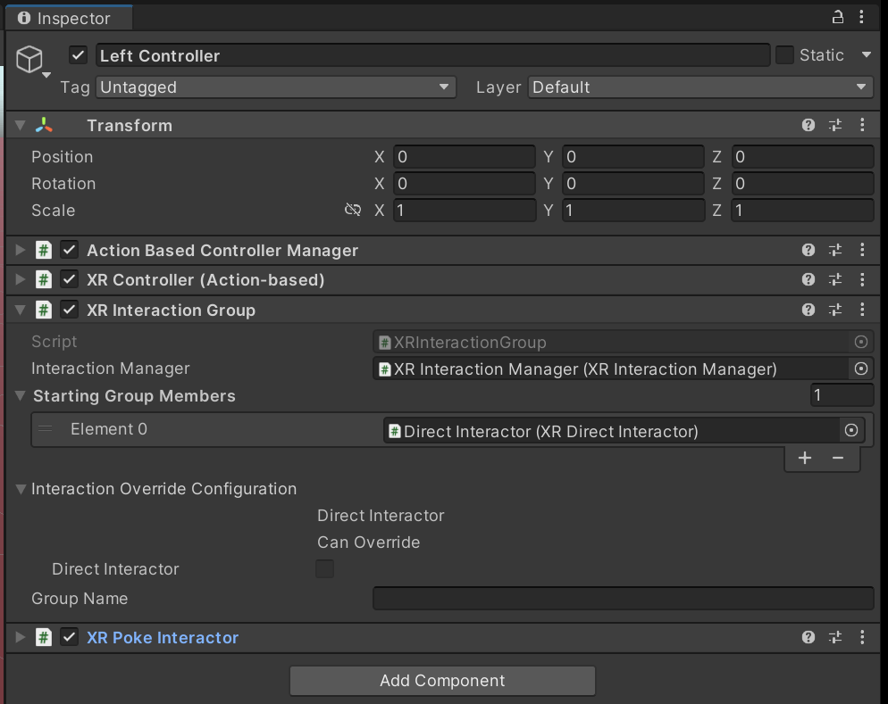
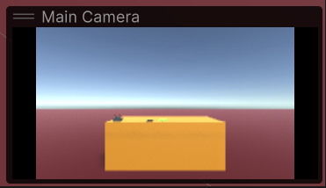
XR Origin(VR)

Slide 5
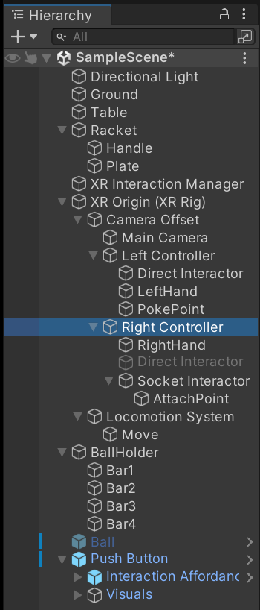
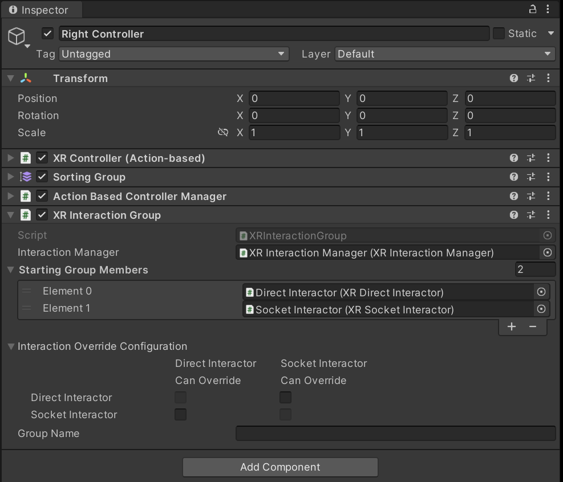
XR Origin(VR)

Slide 6
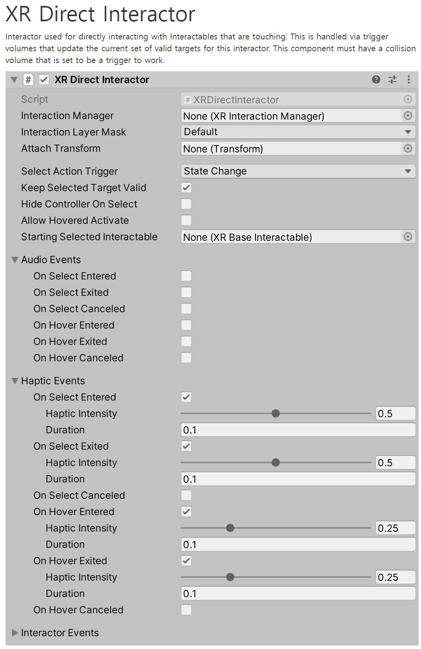
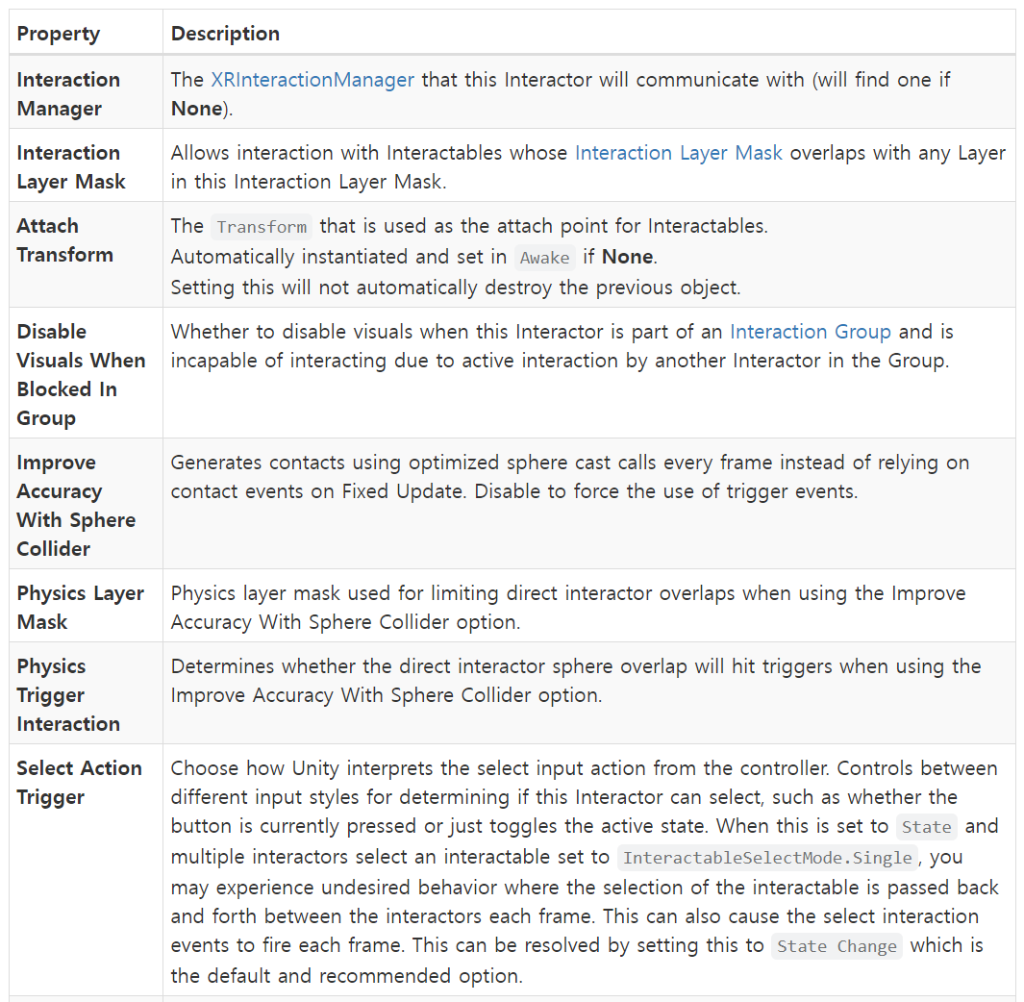
Direct Interactor
Interactor used for directly interacting with Interactables that are touching. This is handled via trigger volumes that update the current set of valid targets for this interactor. This component must have a collision volume that is set to be a trigger to work.

Slide 7
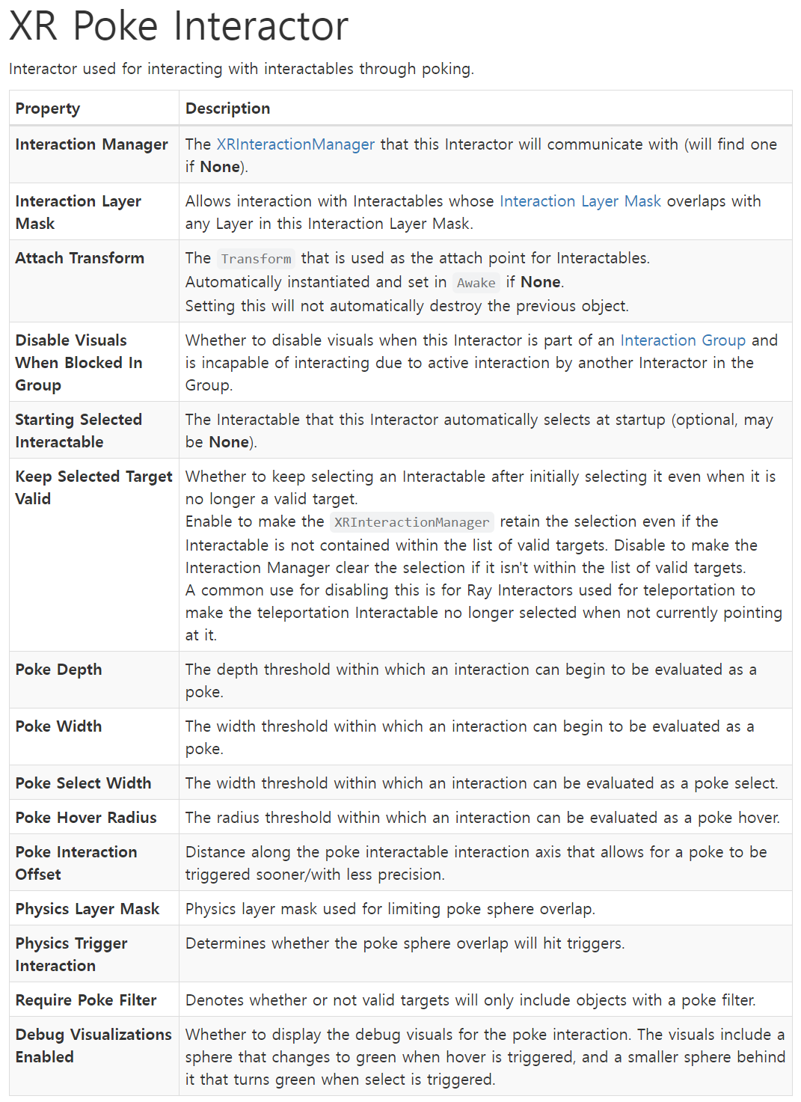
Poke Interactor
Interactor used for interacting with interactables through poking.

Slide 8
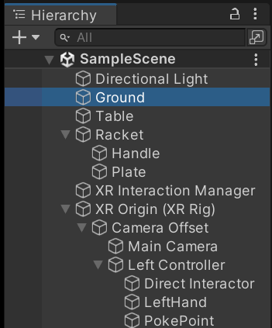
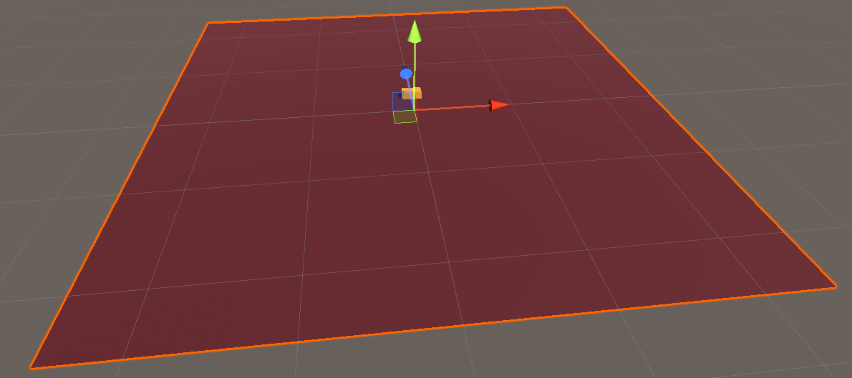
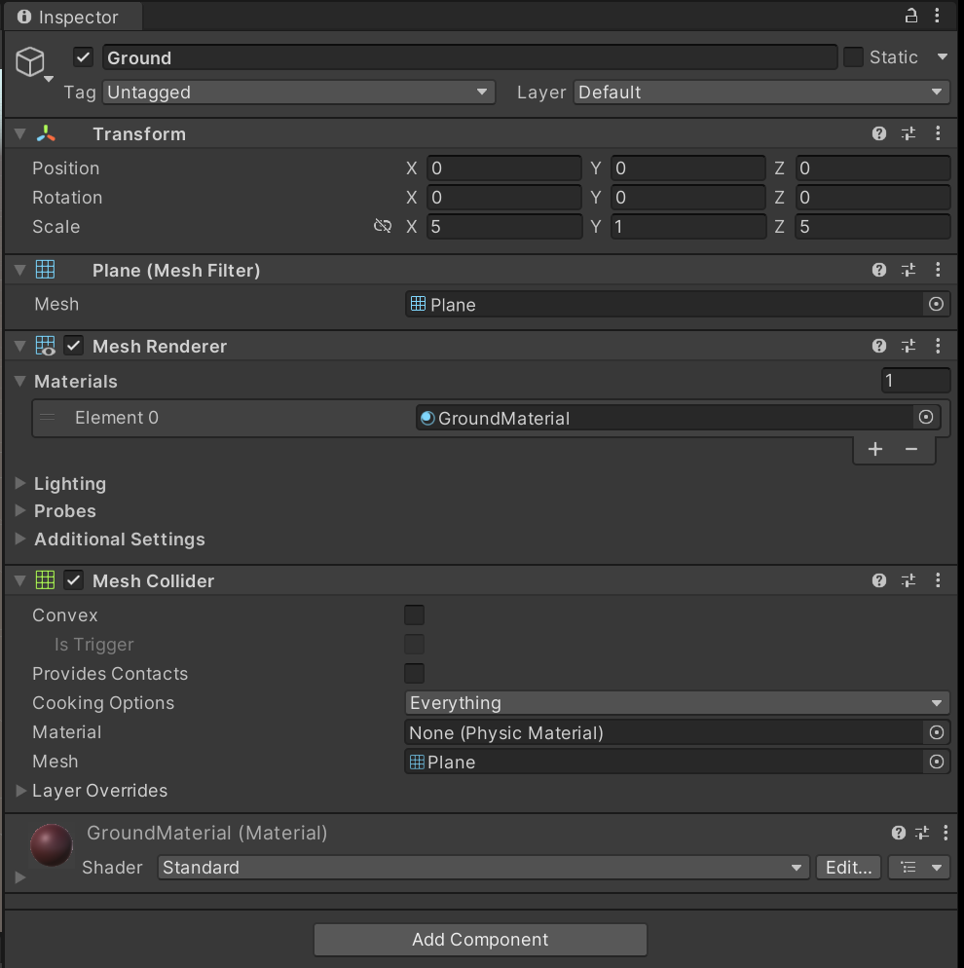
Ground

Slide 9
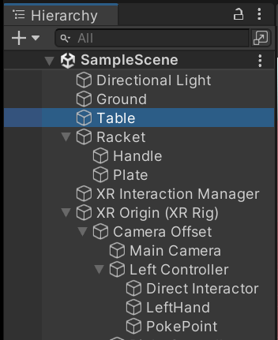
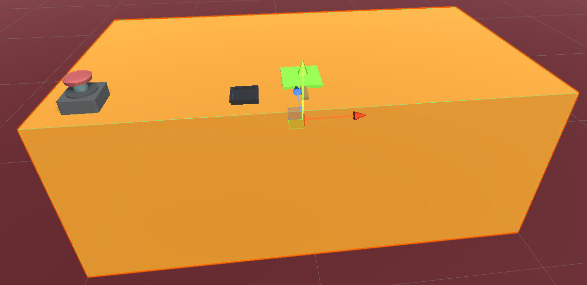
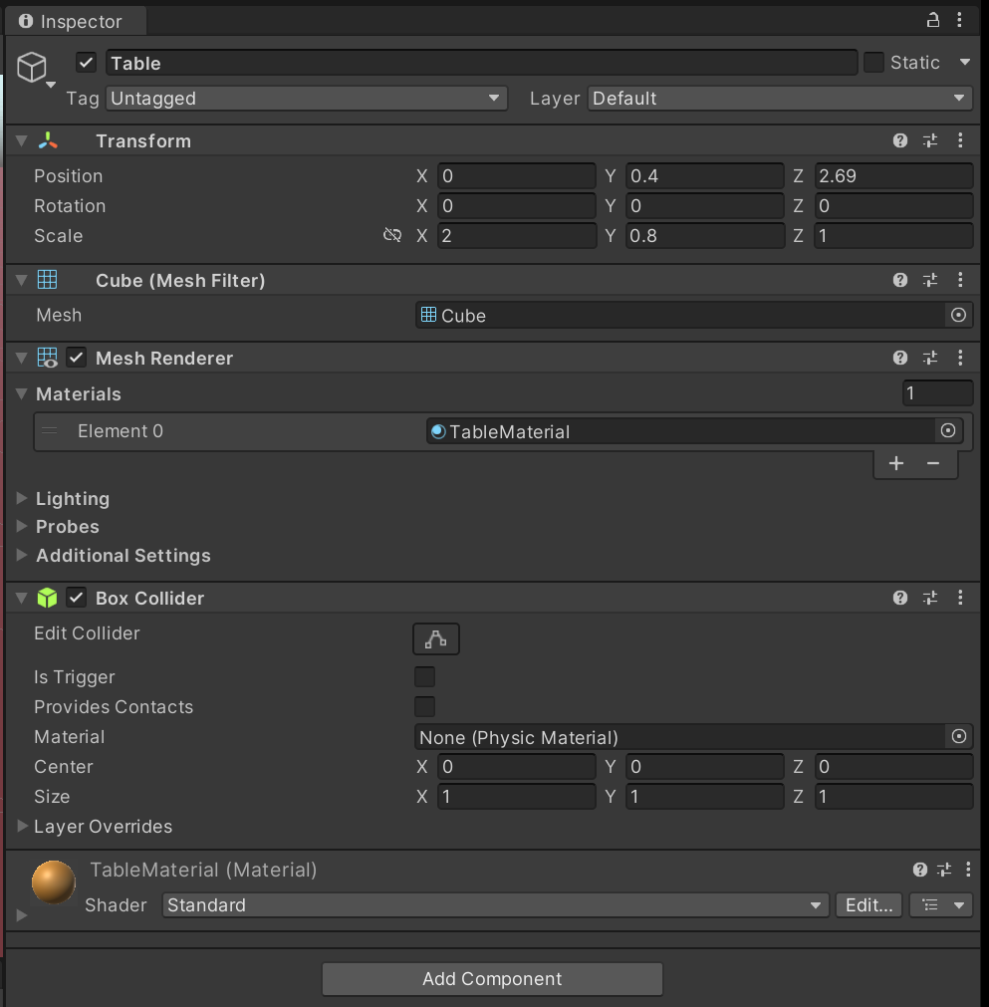
Table

Slide 10
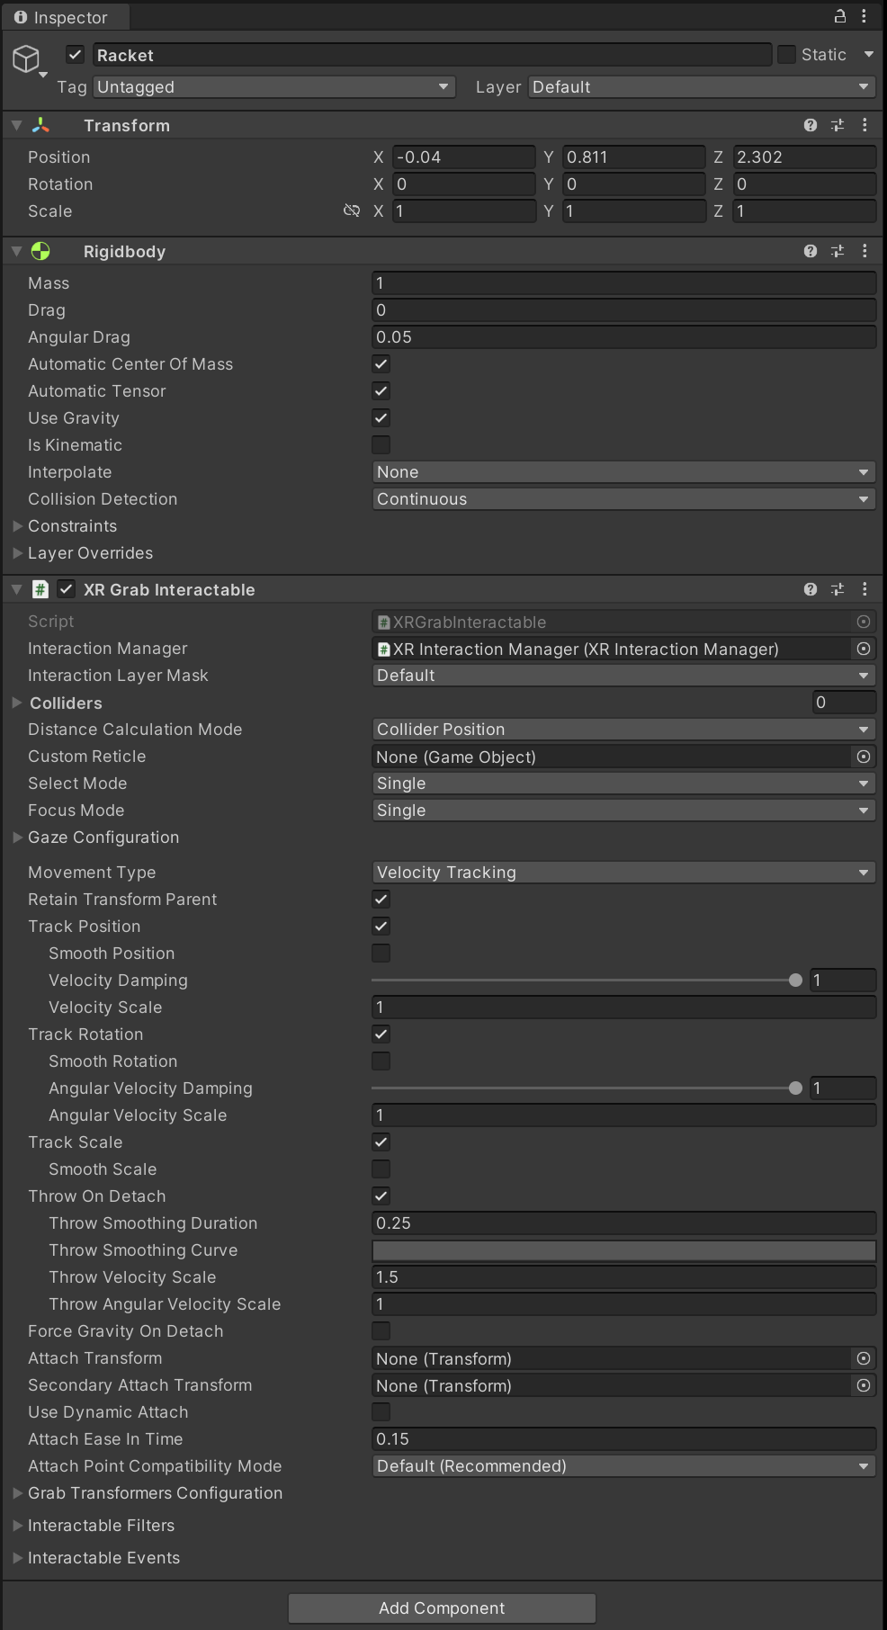
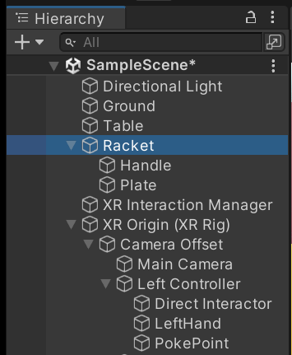
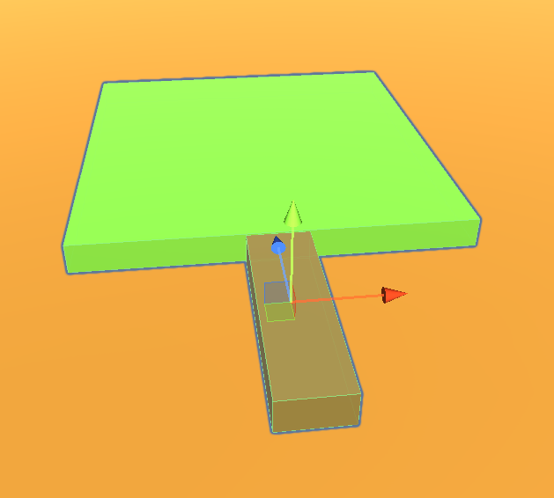
Racket

Slide 11
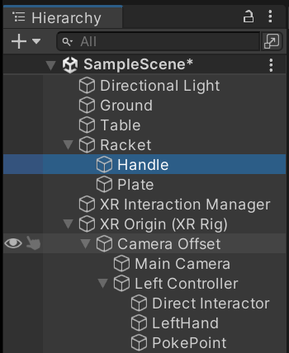
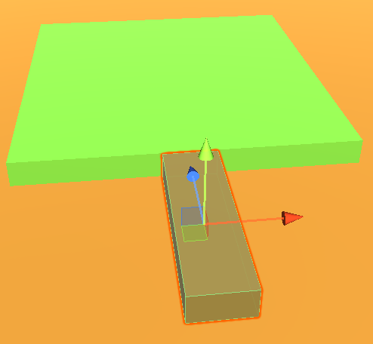
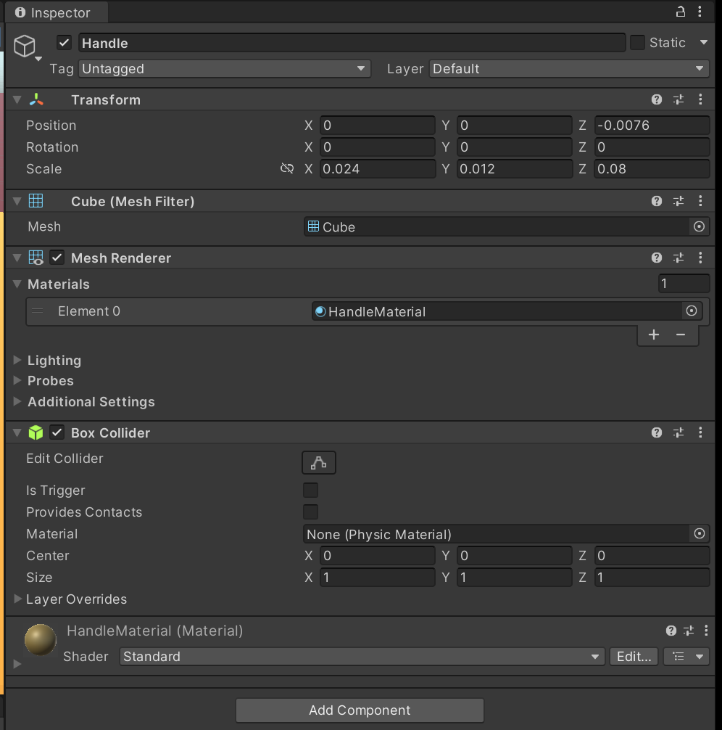
Racket -> Handle

Slide 12
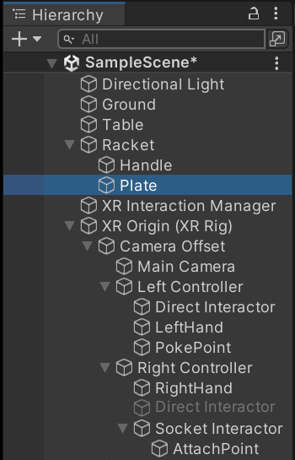
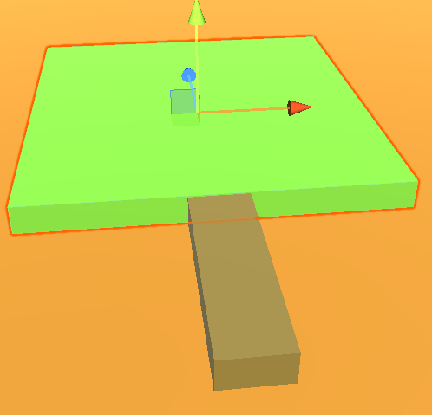
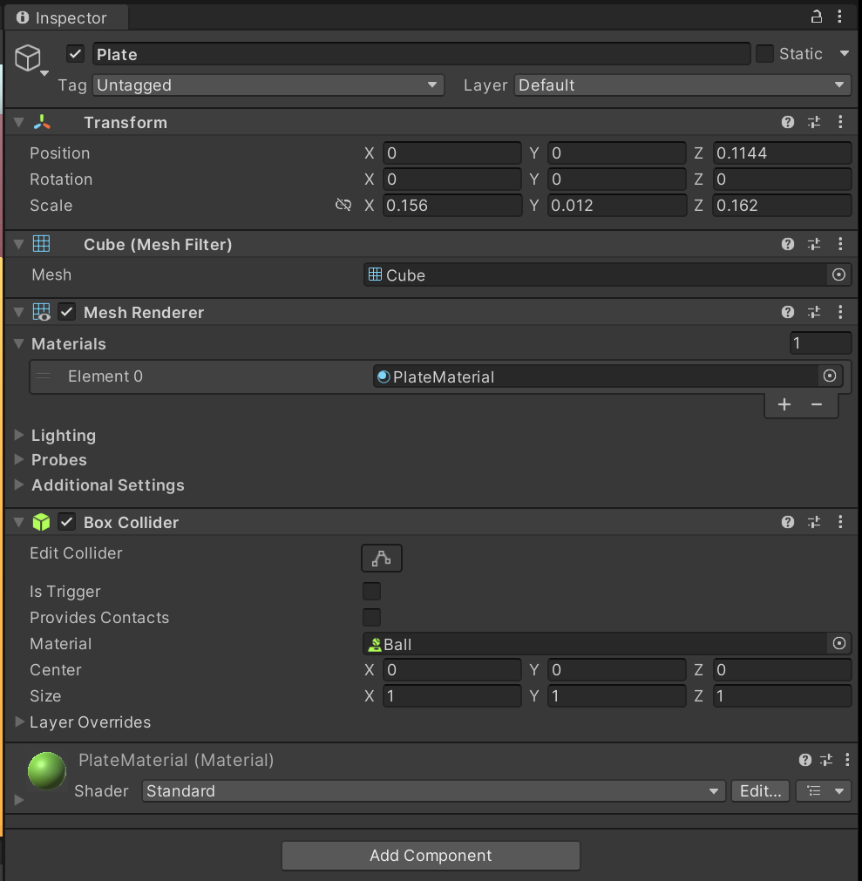
Racket -> Plate

Slide 13
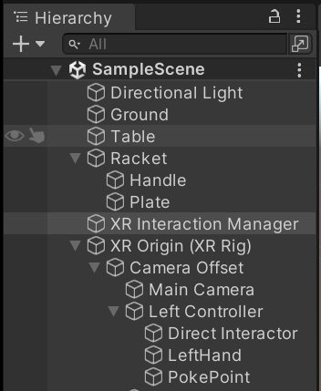
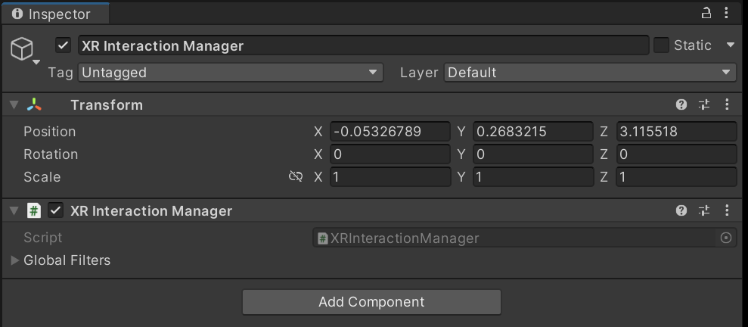
XR Interaction Manager

Slide 14
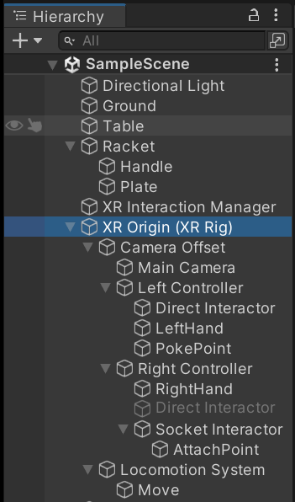
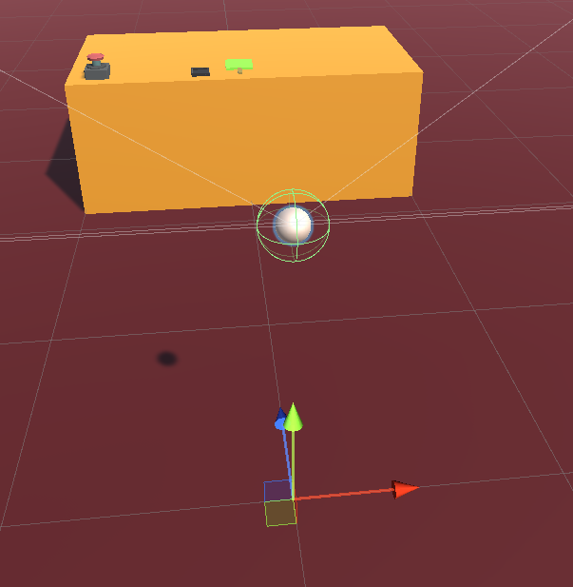
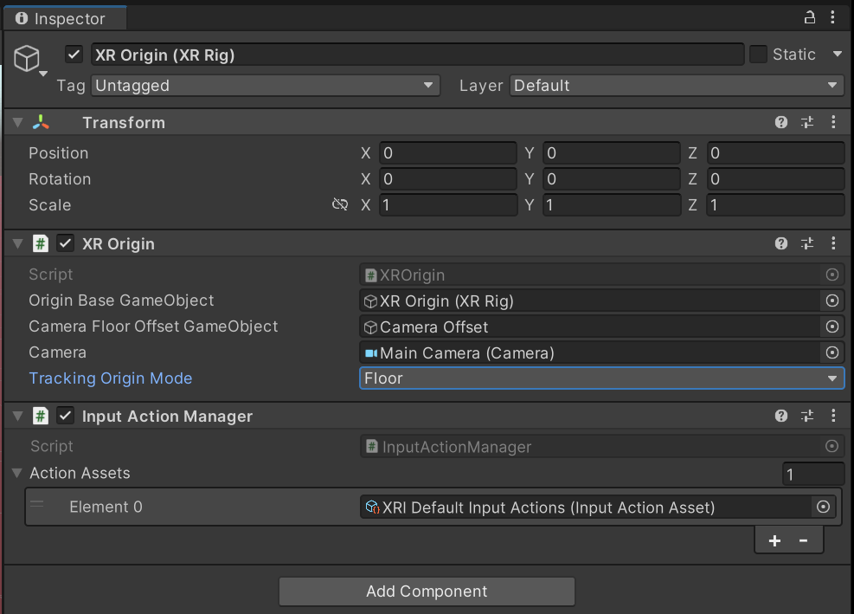
XR Origin (XR Rig)

Slide 15
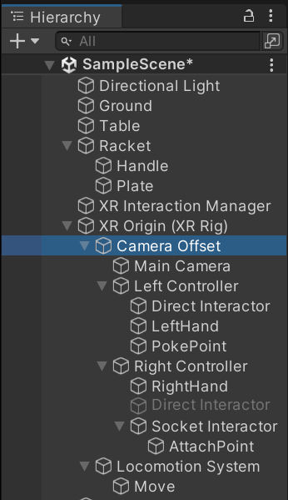
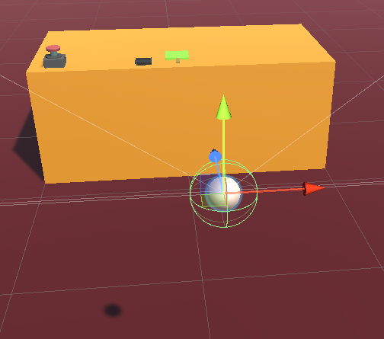
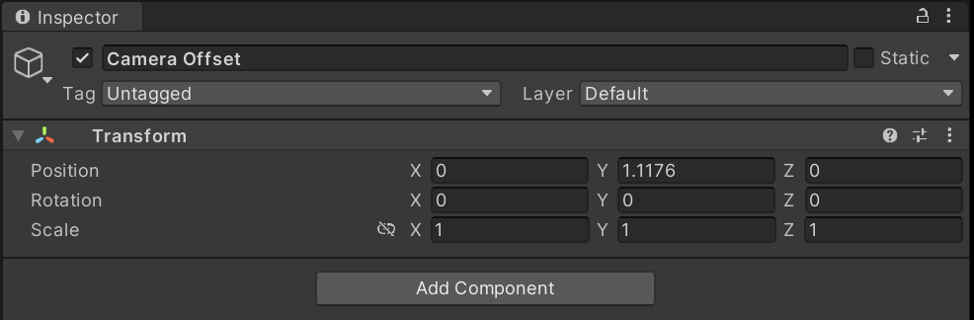
XR Origin (XR Rig) -> Camera Offset

Slide 16
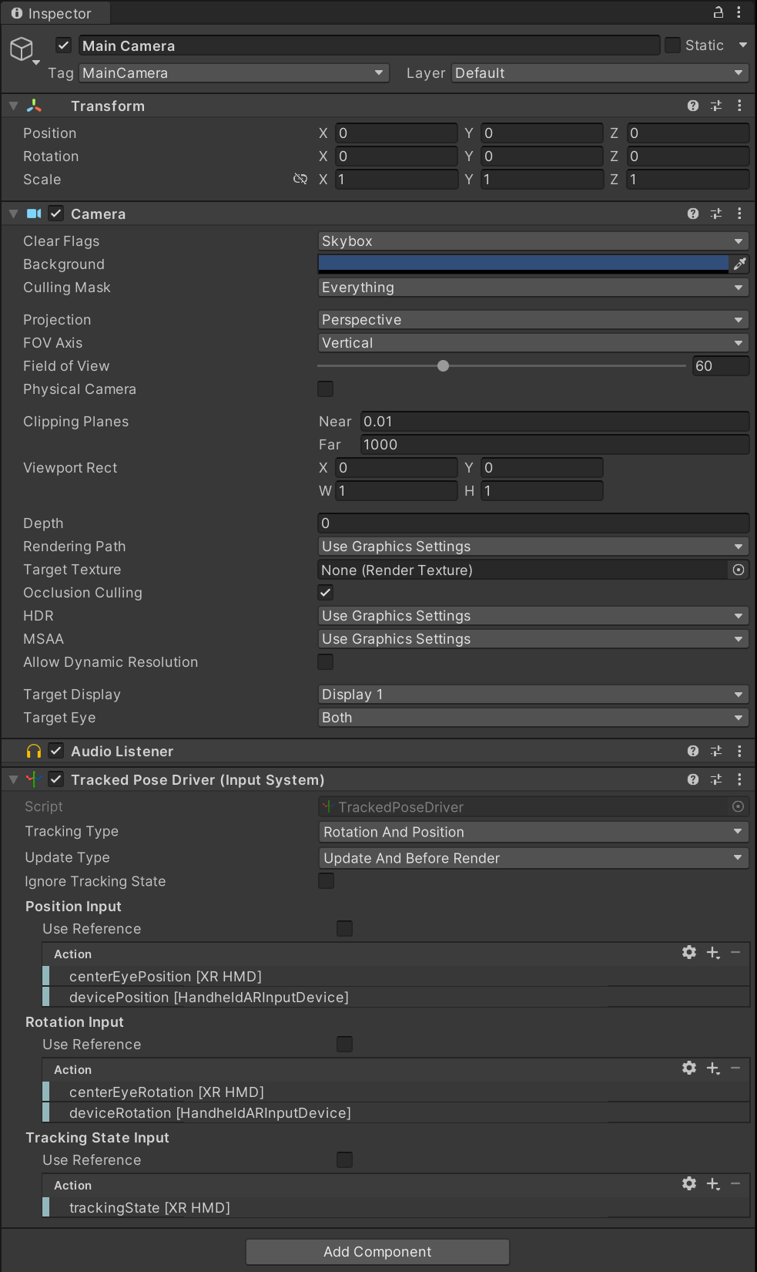
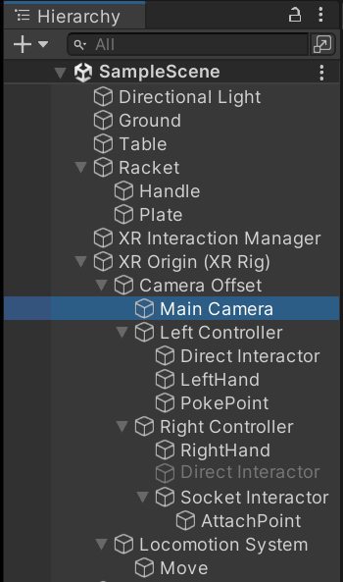
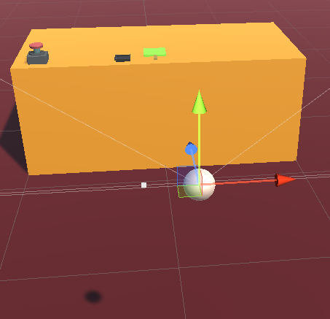
XR Origin -> Camera Offset -> Main Camera

Slide 17
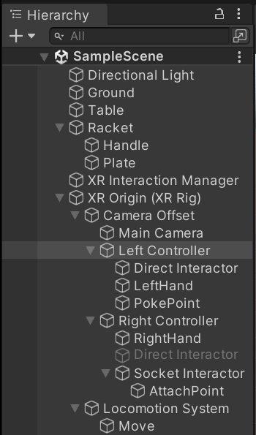
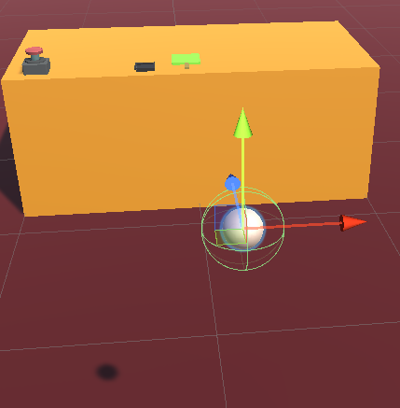
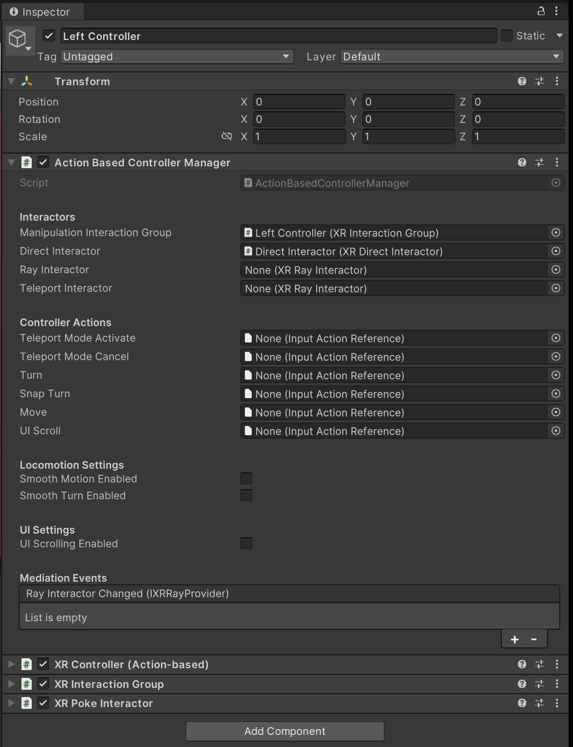
XR Origin -> Camera Offset -> Left Controller

Slide 18
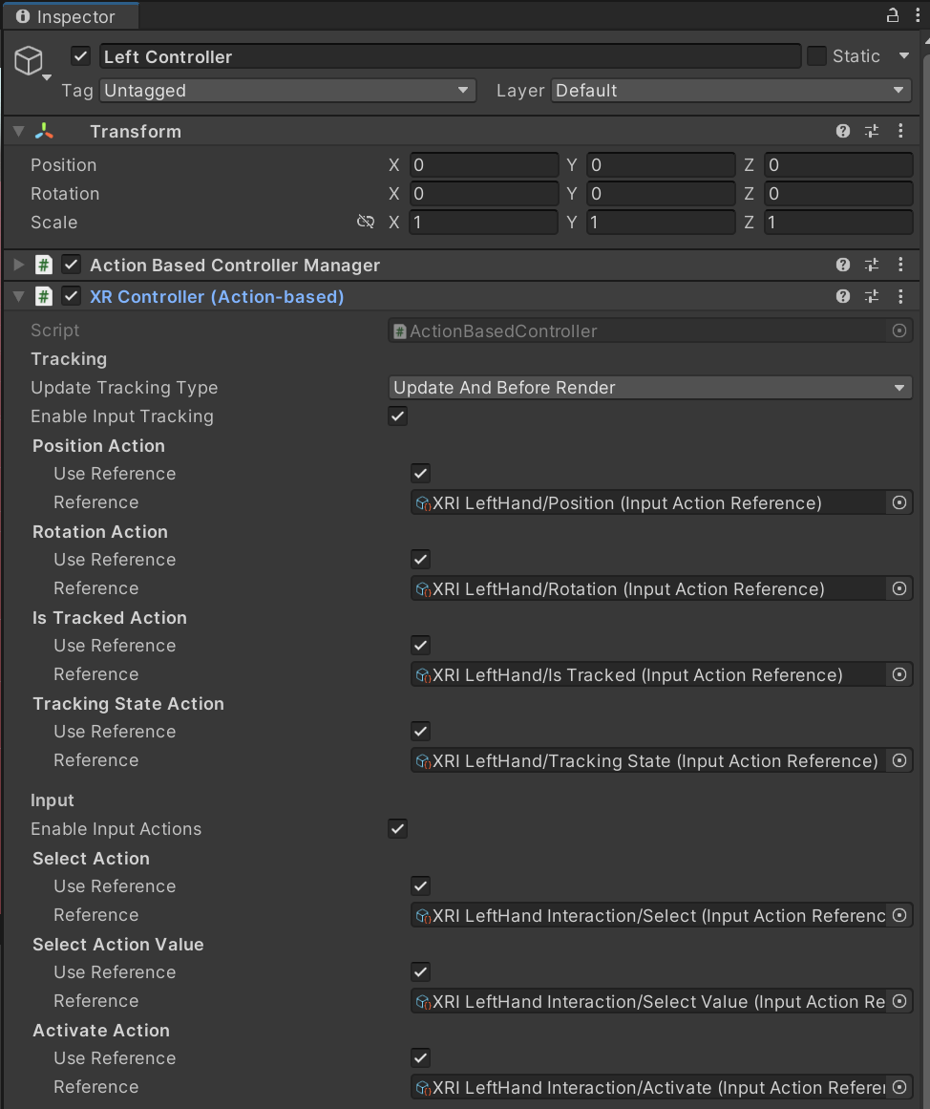
XR Origin -> Camera Offset -> Left Controller

Slide 19
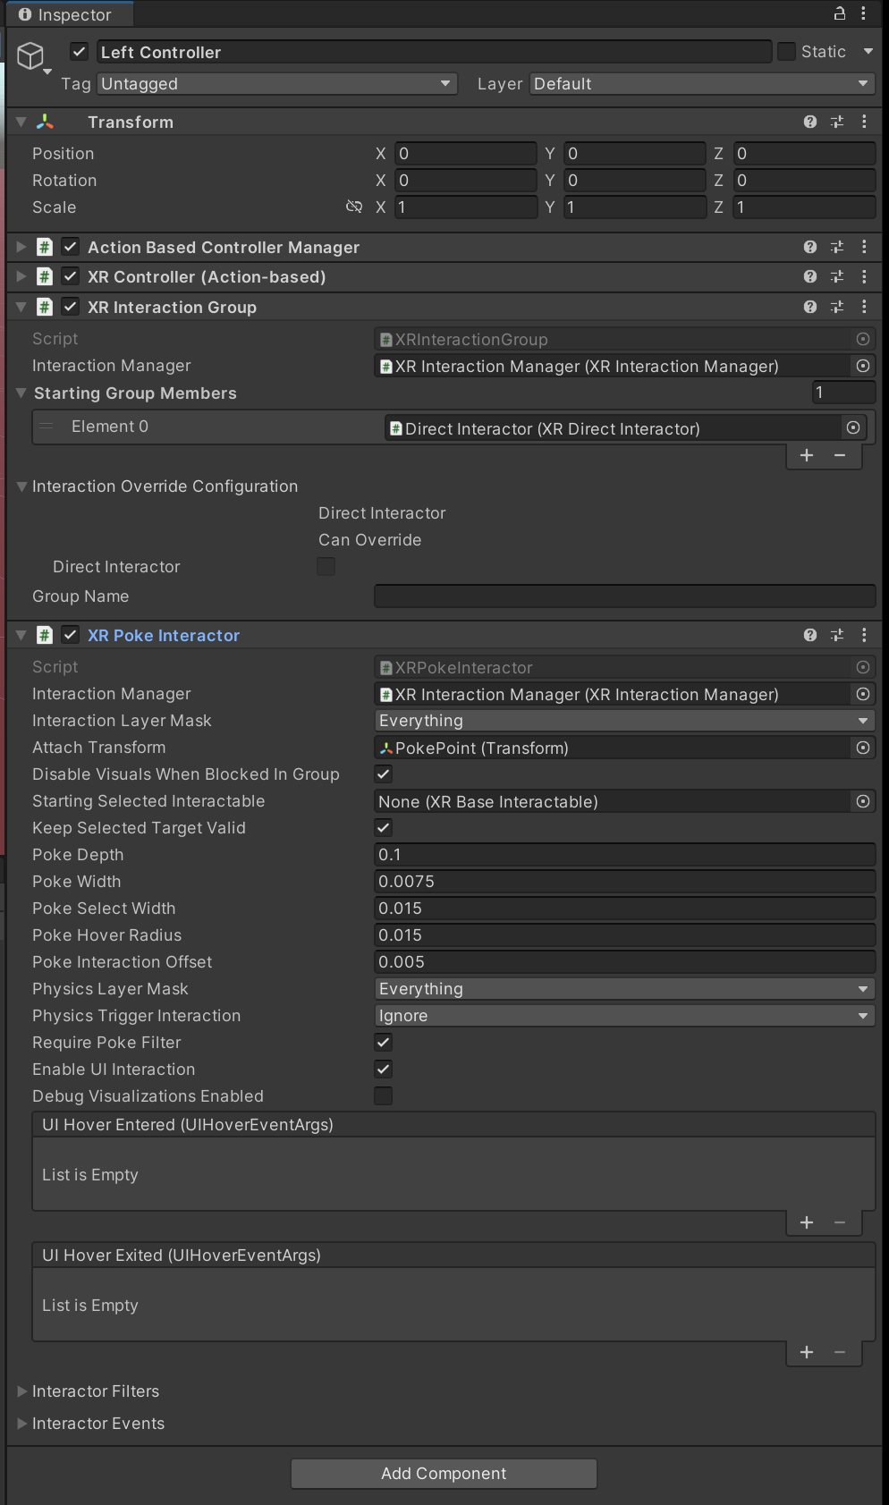
XR Origin -> Camera Offset -> Left Controller

Slide 20
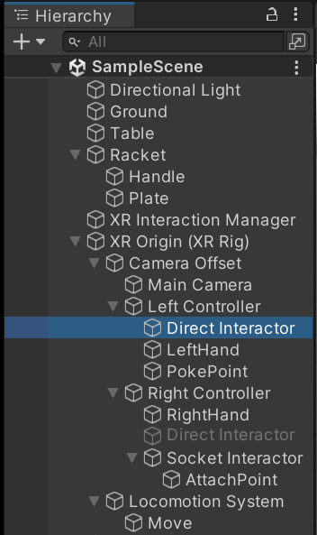
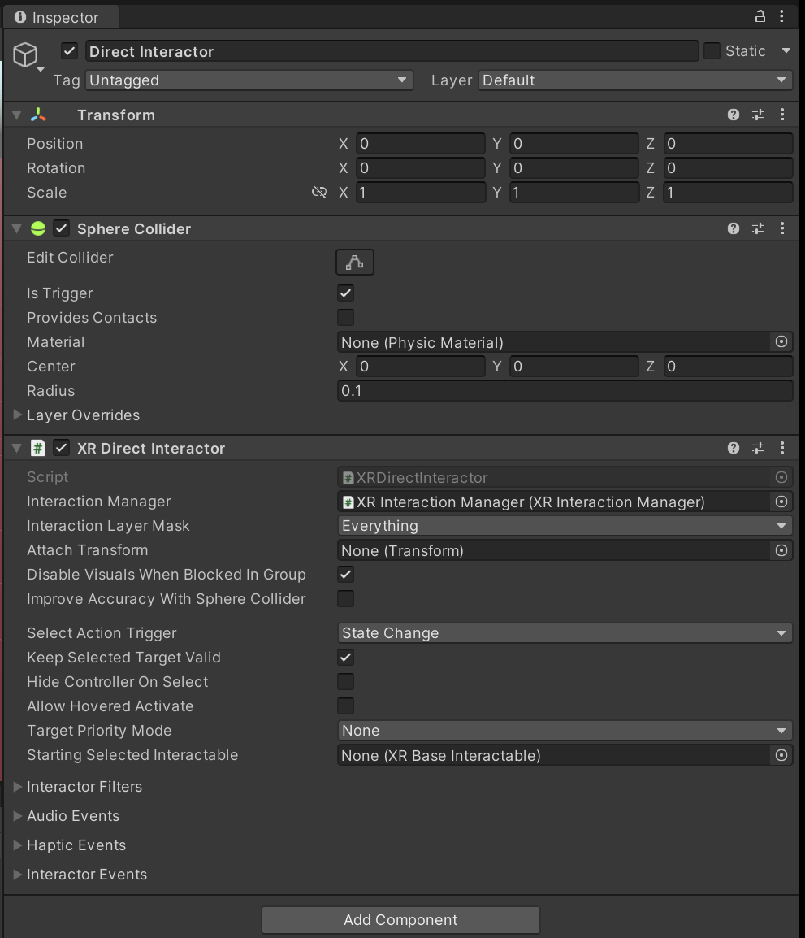
XR Origin -> Camera Offset -> Left Controller -> Direct Interactor

Slide 21
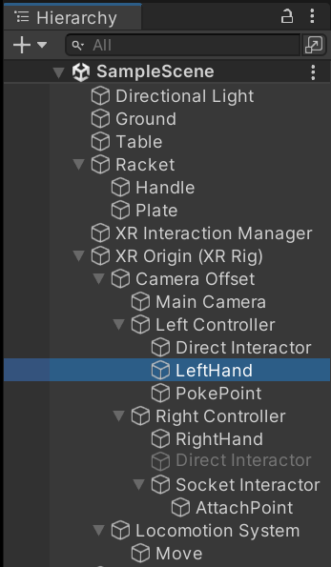
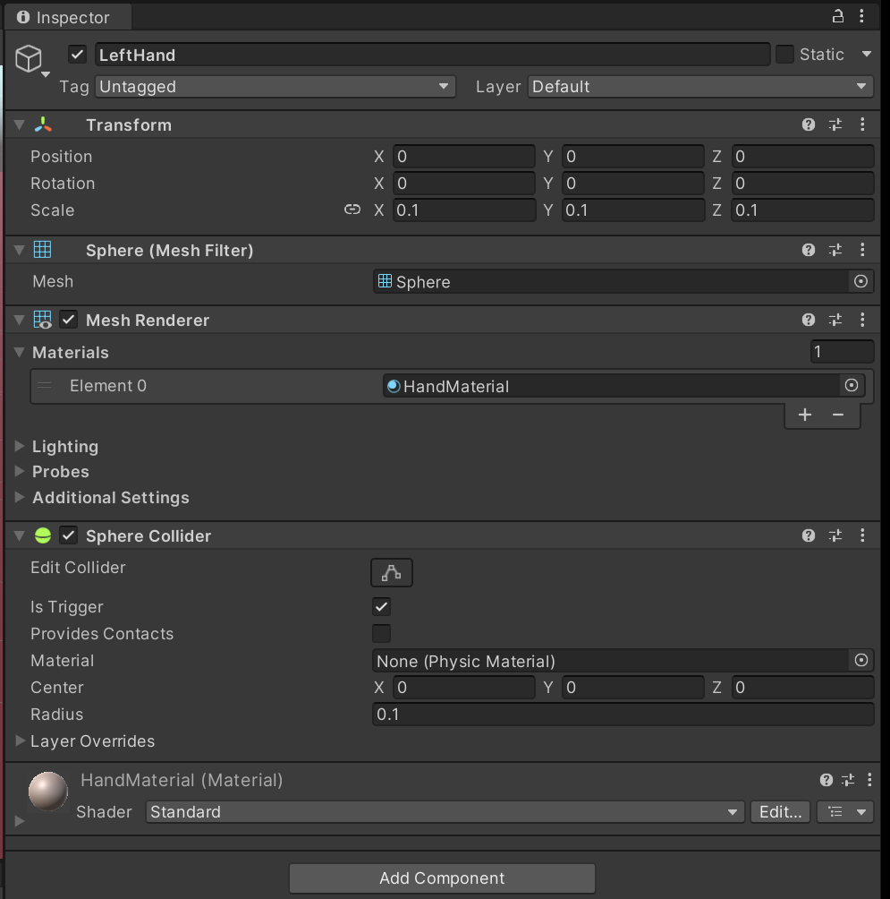
XR Origin -> Camera Offset -> Left Controller -> Left Hand

Slide 22
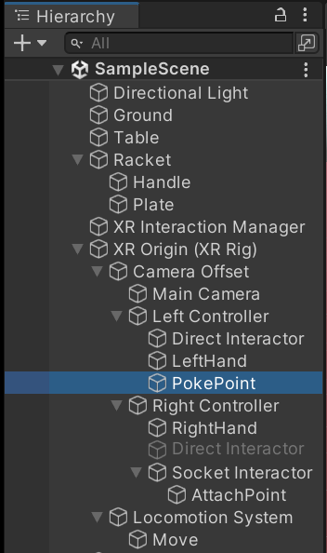
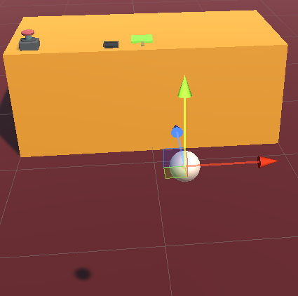
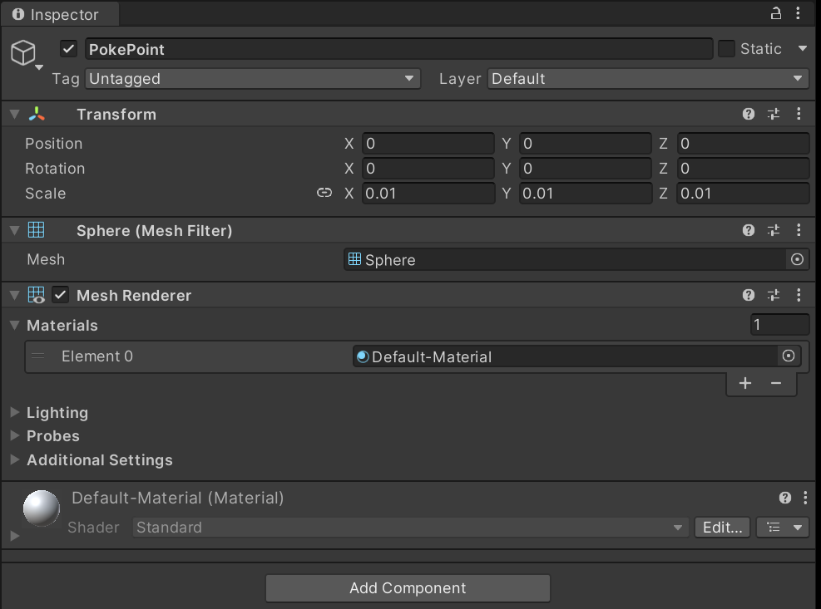
XR Origin -> Camera Offset -> Left Controller -> Poke Point

Slide 23


XR Origin -> Camera Offset -> Right Controller

Slide 24

XR Origin -> Camera Offset -> Right Controller

Slide 25

XR Origin -> Camera Offset -> Right Controller

Slide 26


XR Origin -> Camera Offset -> Left Controller -> Left Hand

Slide 27


XR Origin -> Camera Offset -> Left Controller -> Socket Interactor

Slide 28



XR Origin -> Camera Offset -> Left Controller -> Socket Interactor -> Attach Point

Slide 29



XR Origin -> Locomotion System

Slide 30


XR Origin -> Locomotion System -> Move

Slide 31



BallHolder

Slide 32



BallHolder -> Bar1,2,3,4

Slide 33




Ball

Slide 34

PushButton

Slide 35



Push Button

Slide 36

Push Button

Slide 37


Push Button

Slide 38



LaunchBall Script

Slide 39

Physic Material (Physic Material component reference - Unity 매뉴얼 (unity3d.com))

Slide 40


Ball Physic Material

Slide 41


Physic Material 적용

Slide 42


Physic Material 적용

Slide 43
할일
공을 치는 게임을 완성하시오
공을 치는 게임을 다음과 같이 업그레이드 하시오
공을 치면 점수가 올라가게 하고 점수를 표시하는 UI를 만드시오
공을 치고 공이 도달한 거리에 따라 점수를 다르게 주도록 개선하시오.

